Slide 1
ICON-PRO VR Prototyping Platform
Immersive VR Collaboration for Engineering Teams
Revolutionizing Industrial Prototyping Through Virtual Collaboration
A cost-effective, safe, and collaborative solution for industrial design and workflows

Slide 2

Overview
Industrial prototyping is expensive, time-consuming, and often depends on physical materials and specialized facilities. Collaboration across distributed teams is frequently inefficient, and some industries face safety risks during training or testing. There is a need for cost-effective, safe, and immersive platforms that allow rapid prototyping, design iteration, and collaborative problem-solving in industrial contexts.

Slide 3
Understanding the problems
01
High costs & time: Traditional prototyping involves physical materials, workshops, and specialized facilities → expensive and slow.
02
Collaboration hurdles: Distributed teams rely on video calls, static CAD screenshots, and reports → limited interactivity.
03
Safety concerns: Training/testing on physical industrial setups carries risks (e.g., machinery accidents, hazardous workflows).

Slide 4
Project objective
A VR/AR platform that allows industrial teams to:
Prototype virtually: Import and manipulate 3D models without building physical prototypes.
Visualize designs: Experience them at true scale in immersive VR or overlay them into the real-world environment via AR.
Collaborate in real-time: Multiple stakeholders can join sessions, annotate designs, give instant feedback, and make faster decisions.
Simulate workflows & safety: Test assembly processes, detect inefficiencies, and highlight potential safety risks.

Slide 5

Core Features
3D Model Import & Manipulation
VR Walkthroughs & AR Overlays
Workflow Simulation with Physics
Hazard & Error Detection
Multi-user Collaboration (avatars,voice, annotations)
Version Control & Session Recording

Slide 6

Collaboration Tools
Real-time multi-user sessions
Annotations & markup in 3D space
Role-based access (designer, reviewer, supervisor)
Cloud-based version control

Slide 7

Roadmap
01
MVP CAD Import, VR/AR viewing, Multi-user collaboration
02
Workflow Simulation Physics-based testing, hazard detection, workflow sequencing
03
Enterprise Tools ERP/PLM integration, analytics dashboards, AI-based design optimization

Slide 8

MVP
Upload & view 3D models
Join shared room in VR/AR or browser
Manipulate objects (grab/rotate/scale)
Sync changes live with teammates
Teleport & move around in VR
Add text/voice annotations
Save/export snapshot

Slide 9
Workflow Simulation
Upload – Import CAD/3D model → convert to glTF → store in cloud.
Session – Create room, share link → join via VR/AR/Web.
Explore – View model in VR workshop, AR overlay, or 3D viewer.
Interact – Move, rotate, assemble, hide/show parts.
Collaborate – Avatars, annotations, sketches, highlights.
Test – Simulate workflows, check ergonomics, record sessions.

Slide 10
Enterprise Tools
ERP/PLM Integration – Sync prototypes with business systems (BOM, inventory, lifecycle tracking).
Analytics Dashboards – Track usage, workflow efficiency, safety insights, and cost savings.
AI Optimization – Auto-detect errors, suggest better designs/assembly, predict issues.

Slide 11
Frontend
Dashboard
Displays total projects, active users, time reduction.
Live activity feed & collaboration sessions.
Project Management
Filter/search projects by status or name.
Allows open project (switch view to VR studio) & share project.
Start VR session (placeholder alert).

Slide 12
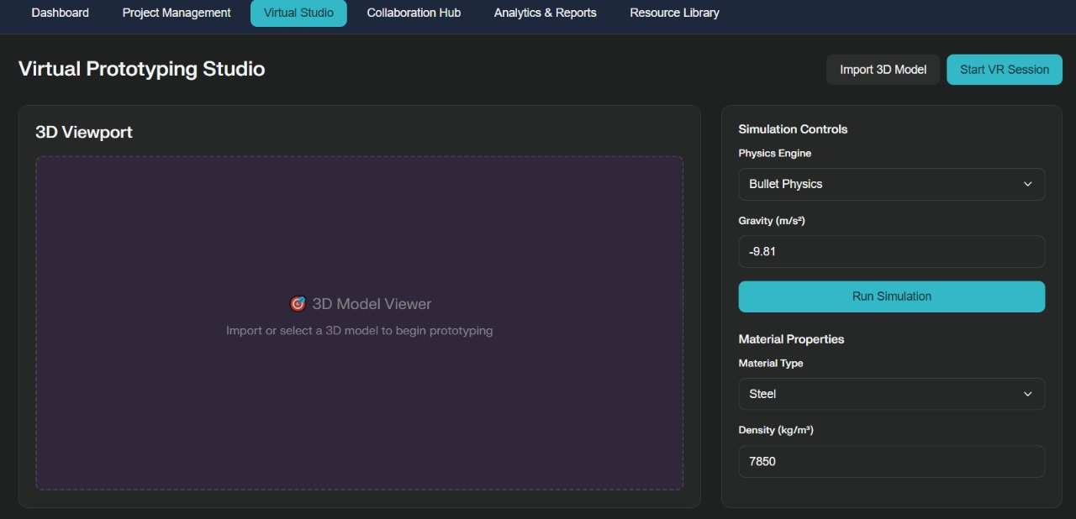

Slide 13
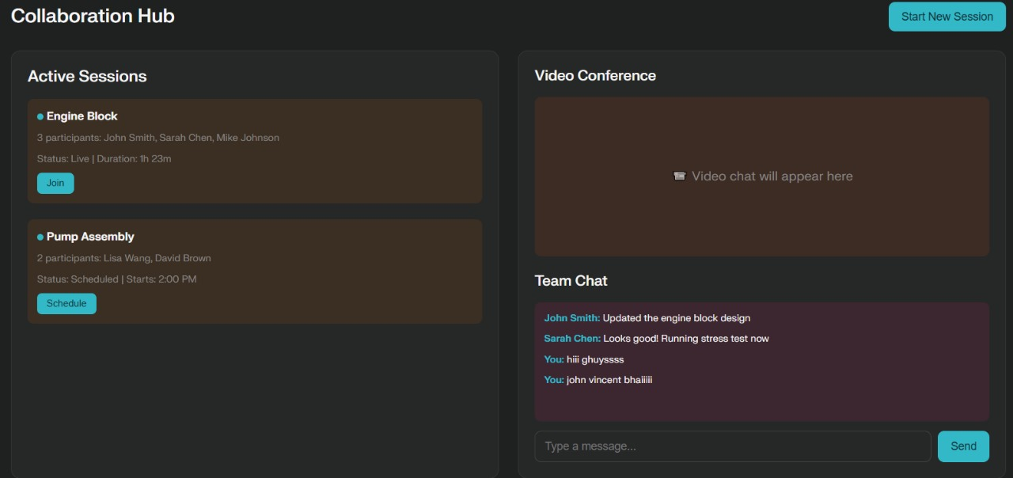

Slide 14

Backend
File upload & convert: turn CAD/STEP into glTF so it works in web/VR.
Realtime server: WebSockets (Node.js) → keeps all users in sync (positions, transforms, annotations).
Storage: S3 or similar cloud bucket for models + snapshots.
Database: Postgres (projects, users, scenes, annotations).
https://docs.google.com/document/d/1NEUX7j_OsvX13mMx6PcL4AvB1Tb0lBJfgrnsW3GV6JM/edit?usp=sharing

Slide 15

Conclusion
This script gives you a functional simulation of the platform with dashboard, analytics, project cards, and basic collaboration tools. It’s a great UI foundation before adding the VR/AR features.

Slide 16

Thank you!
Team members: Divya Brat,Dashmesh Singh, Darshan Sharma,Navya Singhal,Japleen Kaur

